Slide 1
ECG SIGNAL CLASSIFICATION
Submitted by
Mowlidharan A

Slide 2
TASK STATEMENT
You are provided with a dataset containing ECG signals.
Preprocess the data, extract relevant features, build a machine learning model to classify the signals, evaluate model performance, and deploy the model as a web service.

Slide 3
Steps and Deliverables
Dataset Used:
MIT-BIH Arrhythmia Database
Contains labeled ECG recordings from multiple patients
Labels indicate various types of arrhythmias within the recordings
Data Preprocessing:
Utilized the MIT-BIH Arrhythmia Database
Read ECG signals from .csv files and annotations from .txt files
Applied wavelet denoising and z-score normalization
Segmented signals into fixed-size windows (190 samples)

Slide 4
2. Feature Extraction
Extracted features include:
Time-domain features (e.g., RR intervals, QRS duration)
Frequency-domain features (e.g., spectral components)
Wavelet features
Statistical features
Applied Principal Component Analysis (PCA) for dimensionality reduction (retained 95% variance)

Slide 5
3. Model Building
4. Model Evaluation
Train-Test Split: Data split into 80% training and 20% testing sets
Classifiers Trained:
Random Forest
Decision Tree
Logistic Regression
Accuracy
F1-Score (macro average)
Precision (macro average)
Recall (macro average)
ROC-AUC (multi-class 'ovr')

Slide 6
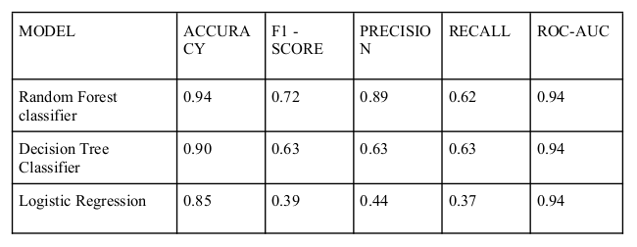
Model Performance
Random Forest outperforms other models across all metrics
Decision Tree shows good accuracy but lower precision and F1-Score
Logistic Regression performs weakest, indicating linear model limitations

Slide 7
Conclusion & Feature Work
Conclusion :
Successfully developed and deployed ECG signal classification system
Random Forest chosen for superior performance
Contribution to cardiac healthcare with practical application in real-world scenarios
Future Work:
Addressing class imbalance
Advanced feature engineering (e.g., wavelet coefficients)
Exploring deep learning models (CNNs, RNNs)
Real-time classification for wearable health monitoring

Slide 8
THANK YOU

